Slide 1
Freshman Training Course Signal
NCTU NSS-Lab 2018
Cheng-Fa Huang
Willy Cheng-Fa Huang
2018.08.14 @NCTU EC-614

Slide 2
Outline
Channel
Friis Transmission Equation
RFID

Slide 3
Outline
Channel
Friis Transmission Equation
RFID
Channel

Slide 4
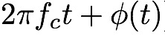
Signal Representation
General form
Called the canonical representation of a
band-pass signal
Q
amplitude
frequency
phase
s(t)
a(t)
a(t)
I
Notes:
這是訊號 gerneral form
IQ domain 上表示
Band pass 訊號典型表示式
還有很多表示訊號的式子

Slide 5
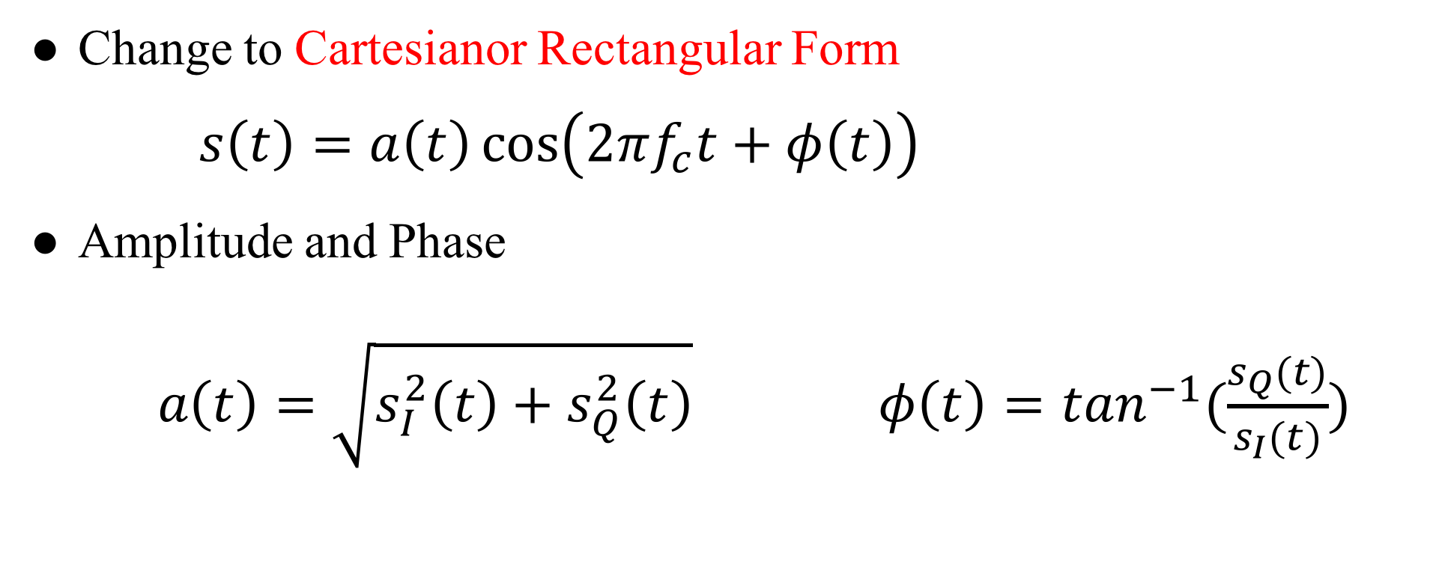
Linear Channels
Change to Cartesianor Rectangular Form
$s\left(t\right)=a\left(t\right)\cos\left(2πf_{c}t+φ\left(t\right)\right)$
Amplitude and Phase
$a\left(t\right)=\sqrt{s_{I}^{2}\left(t\right)+s_{Q}^{2}\left(t\right)} φ\left(t\right)=\tan^{−1}(\frac{s_{Q}(t)}{s_{I}(t)})$
Notes:
ＩＱ座標 轉換 笛卡爾坐標系
ampl. Phase 轉換

Slide 6
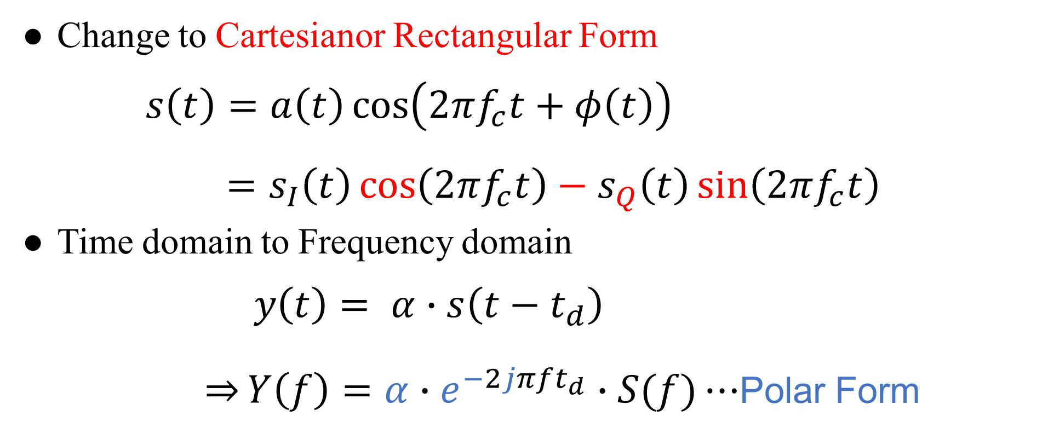
Linear Channels
Change to Cartesianor Rectangular Form
$s\left(t\right)=a\left(t\right)\cos\left(2πf_{c}t+φ\left(t\right)\right)$
$=s_{I}\left(t\right)\cos\left(2πf_{c}t\right)−s_{Q}\left(t\right)\sin\left(2πf_{c}t\right)$
Time domain to Frequency domain
$y\left(t\right)= α∙s\left(t−t_{d}\right)$
$\overset{⇒}{}Y\left(f\right)=α∙e^{−2jπft_{d}}∙S(f)⋯$Polar Form
Notes:
用 剛剛的轉換與 cos 相加 公式拆解
可得笛卡爾座標
Time -> FFT -> freq. 有些地方會寫 $ω=2πf$
今天 focus 這部分 channel

Slide 7
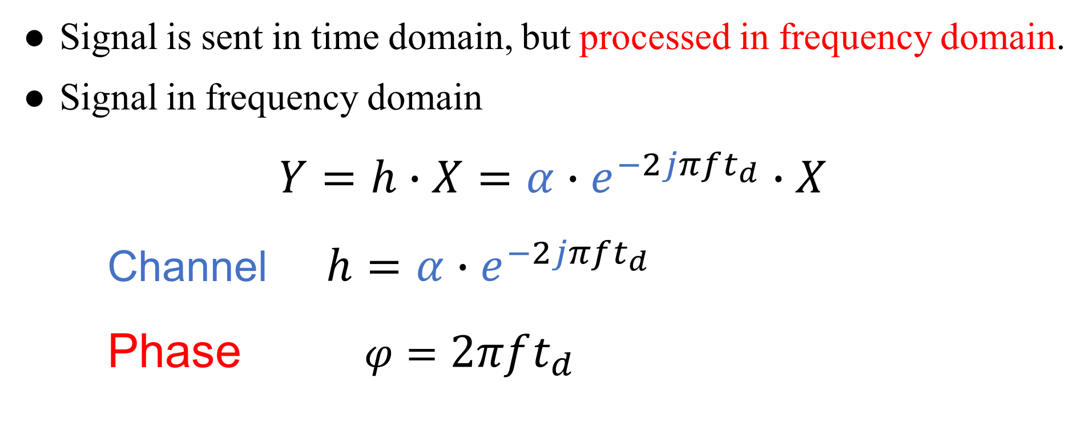
Channel
Signal is sent in time domain, but processed in frequency domain.
Signal in frequency domain
$Y=h∙X=α∙e^{−2jπft_{d}}∙X$
Channel $h=α∙e^{−2jπft_{d}}$
Phase $φ=2πft_{d}$
Notes:
Time domain 送
Frequency domain 分析
記好 channel and phase 的長相

Slide 8
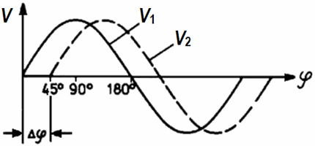
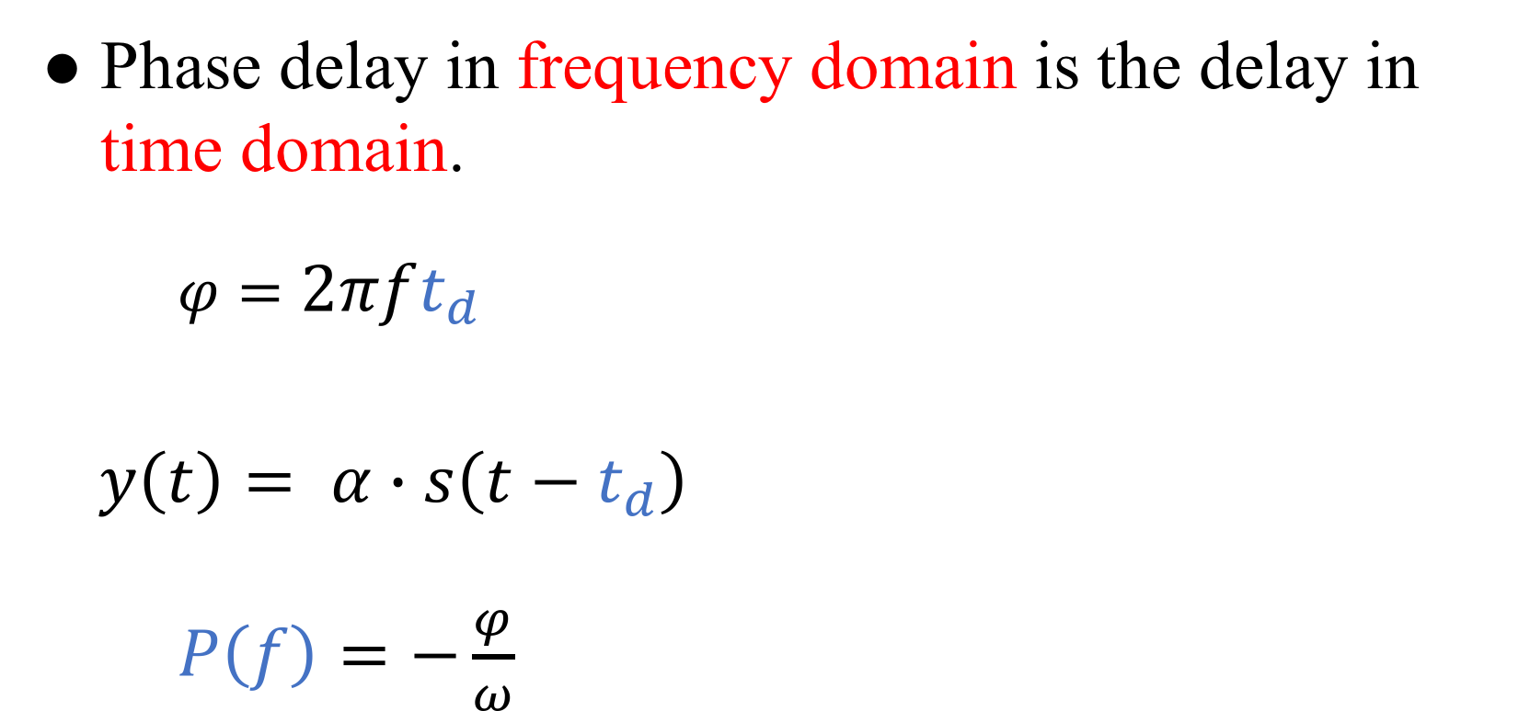
Phase Delay
Phase delay in frequency domain is the delay in time domain.
$φ=2πft_{d}$
$y\left(t\right)= α∙s\left(t−t_{d}\right)$
$P\left(f\right)=−\frac{φ}{ω}$
Notes:
頻域的 phase delay 就是時域的延遲
從第二式可得
P(f) 就是 phase delay

Slide 9
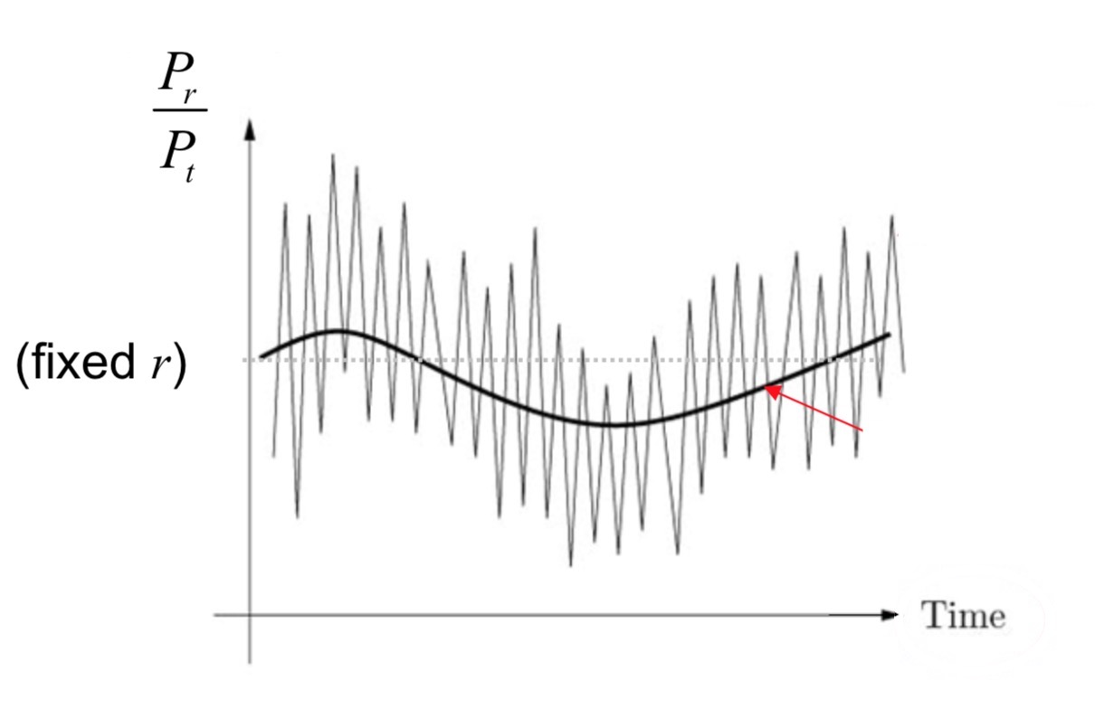
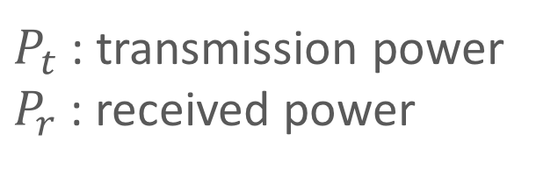
Channel Fading
Fluctuation of the local mean:
Small-scale fading
Fluctuation of the local mean:
Large-scale fading
$P_{t}$ : transmission power
$P_{r}$ : received power
Notes:
時域的訊號圖 送出與接收 power 的比值圖
較大的模型波動稱為 large scale fading
較小的模型波動稱為 small scale fading

Slide 10
Small-Scale Fading
Notes:
先介紹 small scale fading

Slide 11
Channel Fading
Mobility
Slow Fading
Fast Fading
Multipath
Flat Fading
Frequency-selective Fading
Notes:
主要以兩種原因分成四種 fading

Slide 12
Channel Fading
Mobility
Slow Fading
Fast Fading
Multipath
Flat Fading
Frequency-selective Fading
Mobility
Slow Fading
Fast Fading
Notes:
在這先介紹以移動影響 channel 的其中兩種 fading

Slide 13
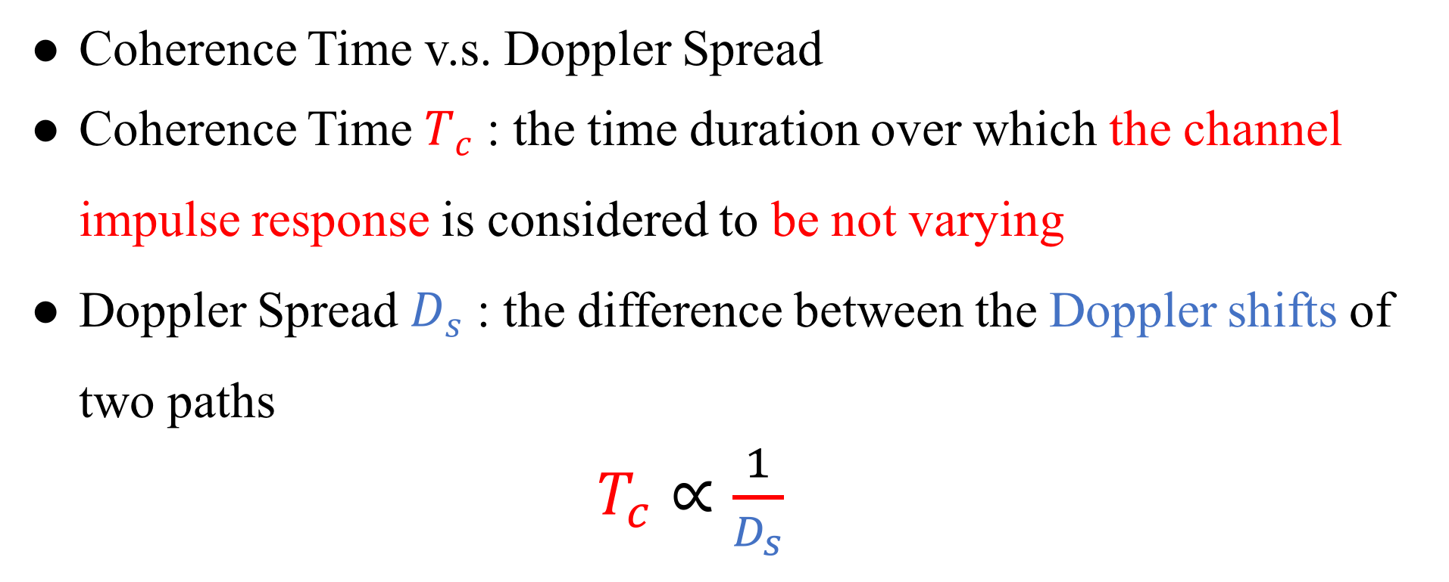
Channel Fading
Coherence Time v.s. Doppler Spread
Coherence Time $T_{c}$ : the time duration over which the channel impulse response is considered to be not varying
Doppler Spread $D_{s}$ : the difference between the Doppler shifts of two paths
$T_{c}∝\frac{1}{D_{s}}$
Notes:
因為是 移動的影響 所以頻域方面會考慮 Doppler 效應
Coherence time 就是一段時間 channel impulse response 沒有改變
Tc Ds 成反比

Slide 14
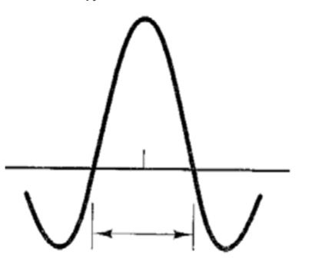
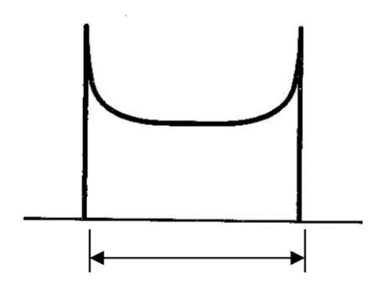



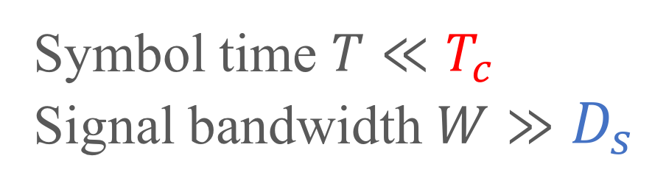
Channel Fading
Time Domain
Frequency Domain
$T_{c}∝\frac{1}{D_{s}}$
FFT
iFFT
$$T_{c}$$
$$D_{s}$$
Coherence time
Doppler Spread
Symbol time $T≪T_{c}$
Signal bandwidth $W≫D_{s}$
Slow Fading
Notes:
先定義 threshold Tc Ds
Symbol time < Tc W>Ds slow

Slide 15
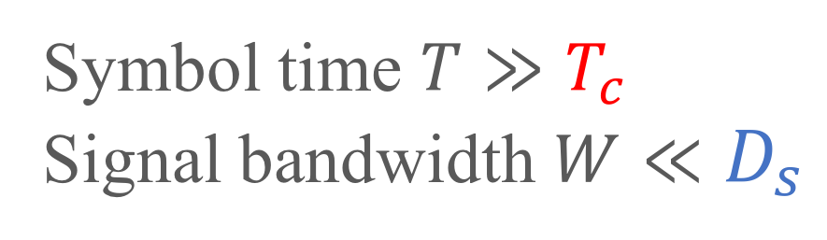
Channel Fading
Time Domain
Frequency Domain
$T_{c}∝\frac{1}{D_{s}}$
FFT
iFFT
$$T_{c}$$
$$D_{s}$$
Coherence time
Doppler Spread
Symbol time $T≫T_{c}$
Signal bandwidth $W≪D_{s}$
Fast Fading
Notes:
相反地就是 fast

Slide 16
Channel Fading
Mobility
Slow Fading
Fast Fading
Multipath
Flat Fading
Frequency-selective Fading
Multipath
Flat Fading
Frequency-selective Fading
Notes:
接下來介紹以 multipath 影響 channel 的其中兩種 fading

Slide 17
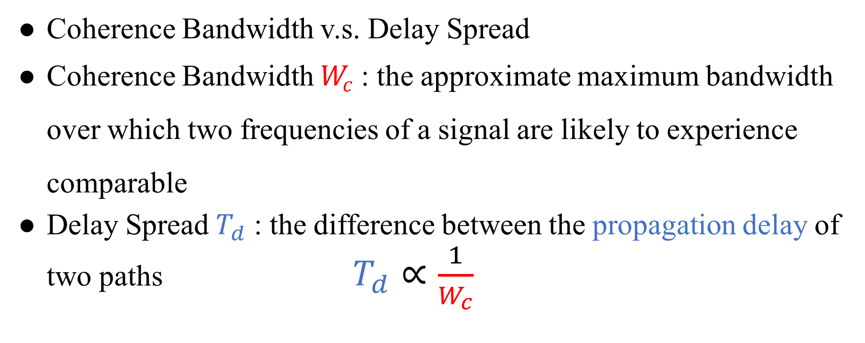
Channel Fading
Coherence Bandwidth v.s. Delay Spread
Coherence Bandwidth $W_{c}$ : the approximate maximum bandwidth over which two frequencies of a signal are likely to experience comparable
Delay Spread $T_{d}$ : the difference between the propagation delay of two paths $T_{d}∝\frac{1}{W_{c}}$
Notes:
針對 multipath 由兩個指標做判斷
Coherence Bandwidth : 兩訊號大致最大的頻寬
Delay Spread : 兩段路徑的 propagation delay 的差距

Slide 18
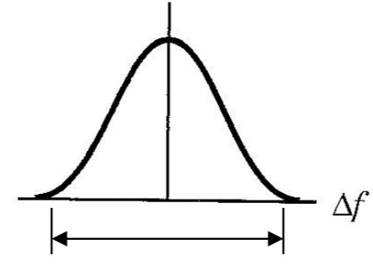
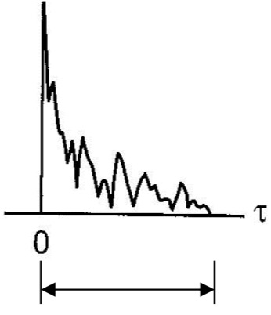



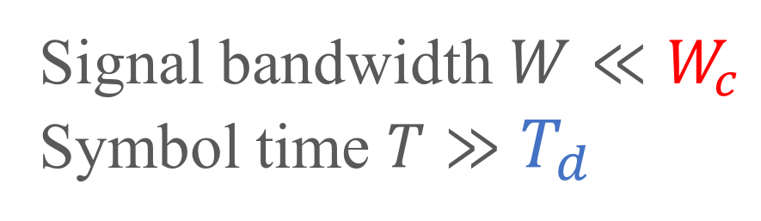
Channel Fading
Frequency Domain
Time Domain
$W_{c}∝\frac{1}{T_{d}}$
iFFT
FFT
$$W_{c}$$
$$T_{d}$$
Coherence Bandwidth
Delay Spread
Signal bandwidth $W≪W_{c}$
Symbol time $T≫T_{d}$
Flat Fading
Notes:
訊號在頻域的比閥值小而時域超過 delay spread

Slide 19
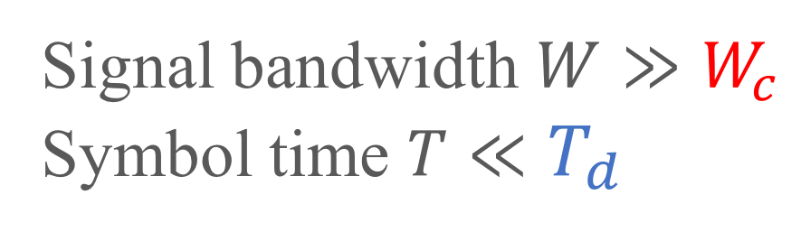
Channel Fading
Frequency Domain
Time Domain
$W_{c}∝\frac{1}{T_{d}}$
iFFT
FFT
$$W_{c}$$
$$T_{d}$$
Coherence Bandwidth
Delay Spread
Frequency-selective
Fading
Signal bandwidth $W≫W_{c}$
Symbol time $T≪T_{d}$
Notes:
相反稱為 Frequency-selective Fading

Slide 20
Large-Scale Fading
Notes:
前面介紹的是 small scale fading
接下來介紹 large scale fading

Slide 21
Path Loss
Linear path loss of the channel is the ratio of transmit
power to receive power.
The power of received signal is averaged over any random
variations due to shadowing.
Shadowing is the effect that the received signal power
fluctuates due to objects obstructing the propagation path
between tx and rx.
Notes:
看 Path loss 主要是看送出比上收到的能量
收到的訊號會受到 fading 的影響稱為 shadowing
最常見的就是 tx rx 間的傳送路徑有東西阻擋

Slide 22
Outline
Channel
Friis Transmission Equation
RFID
Friis Transmission Equation
Notes:
針對 path loss 的描述
Friis 提出一個公式來表達

Slide 23
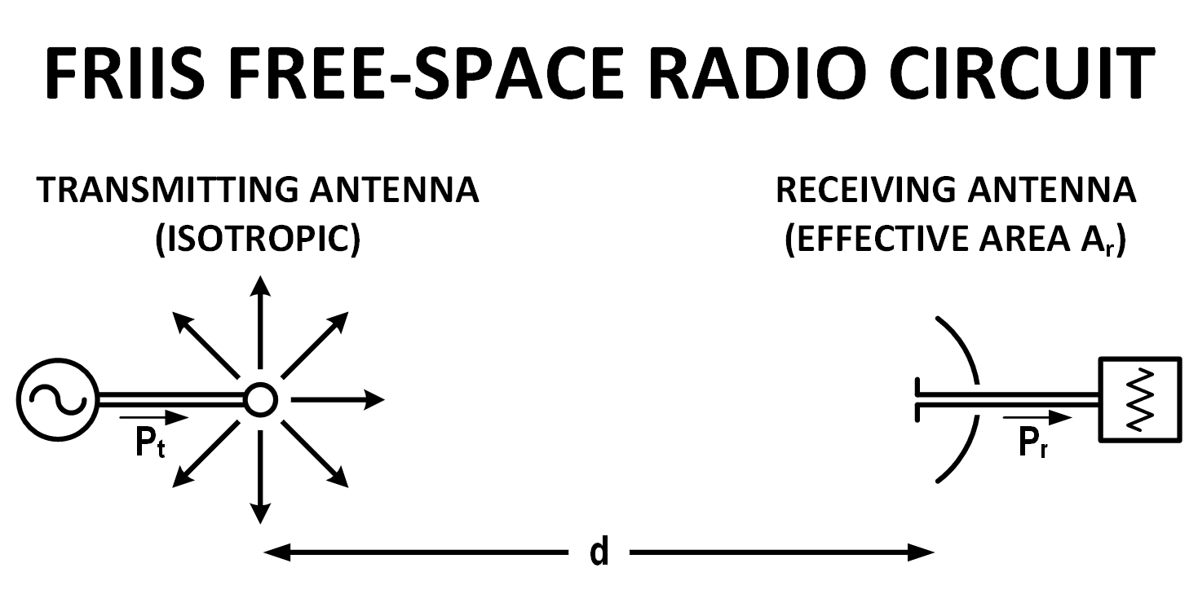
Why Friis’ Formula
Dispense with the usage of directivity or gain when describing antenna performance
Descriptor of antenna capture area
Notes:
通常會用 gain 表達天線的 performance
Friis 認為現有的公式都太多係數要記
Capture area 展現 free space radio circuit 的特色

Slide 24
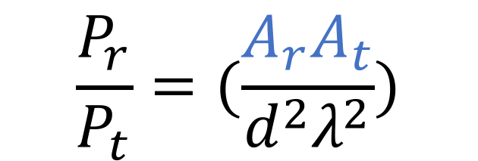
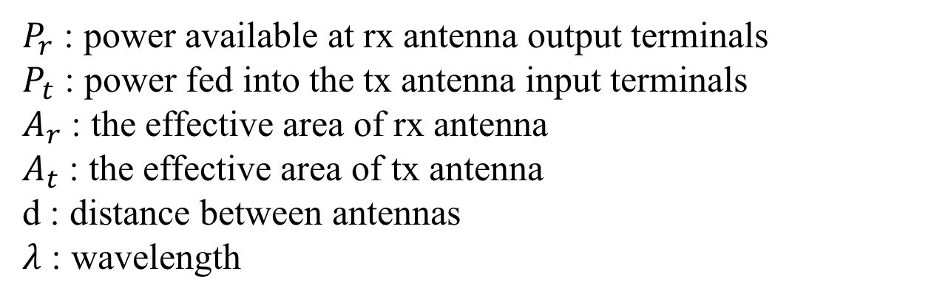
Friis’ Original Formula
$$\frac{P_{r}}{P_{t}}=(\frac{A_{r}A_{t}}{d^{2}λ^{2}})$$
$P_{r}$ : power available at rx antenna output terminals
$P_{t}$ : power fed into the tx antenna input terminals
$A_{r}$ : the effective area of rx antenna
$A_{t}$ : the effective area of tx antenna
d : distance between antennas
$λ$ : wavelength
Notes:
單純用可以量測的數據描述收到及送出訊號的能量比值

Slide 25
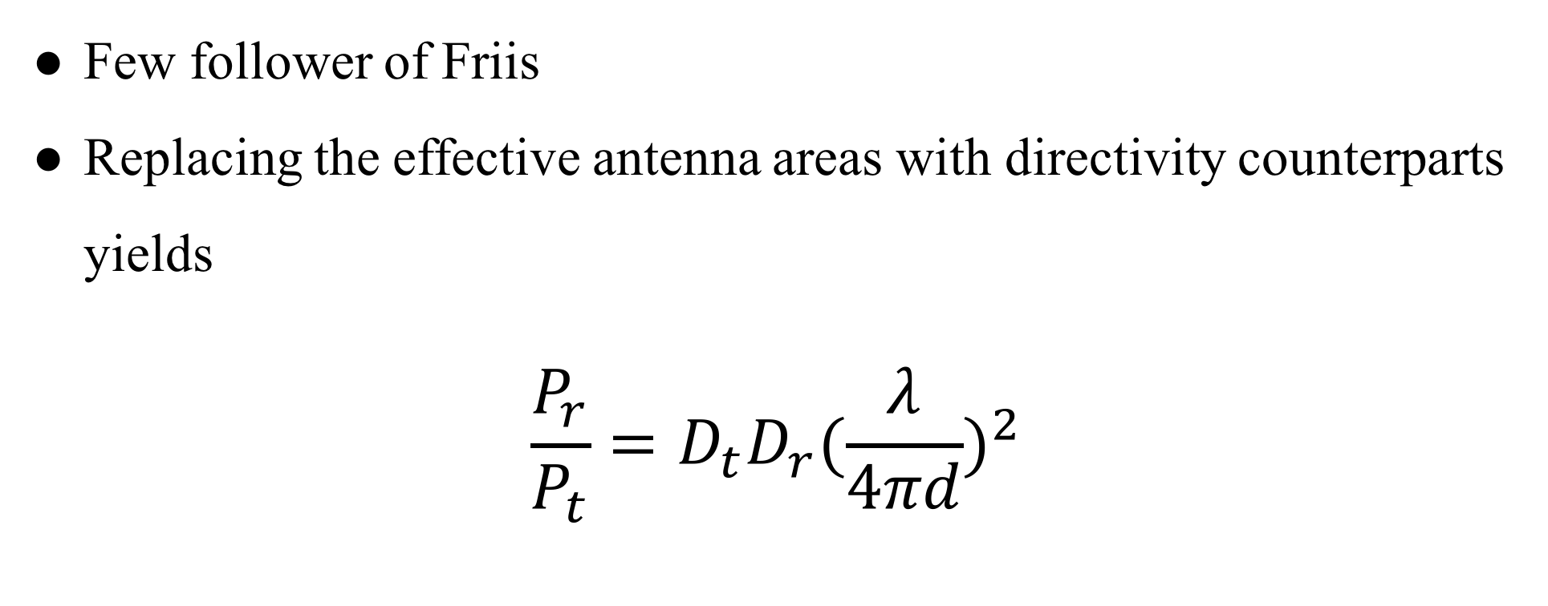
Contemporary Formula
Few follower of Friis
Replacing the effective antenna areas with directivity counterparts yields
$$\frac{P_{r}}{P_{t}}=D_{t}D_{r}{(\frac{λ}{4πd})}^{2}$$
Notes:
但後來大家都不用 有效天線面積 而改用 antenna directivities
D 的介紹投影片有，有興趣可自行閱讀

Slide 26
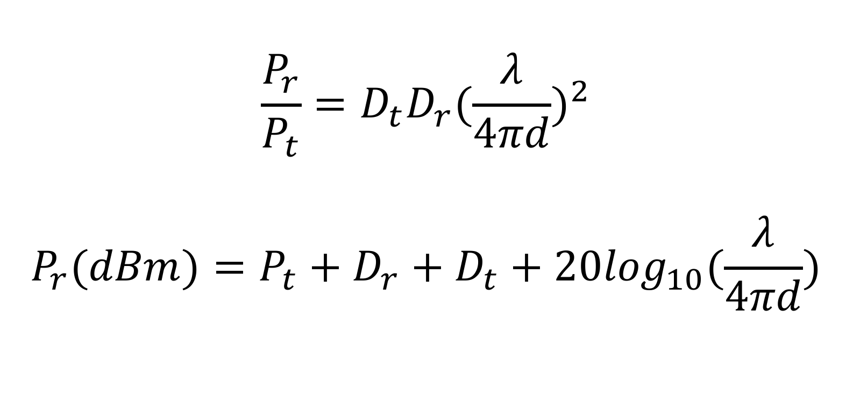
Contemporary Formula
$$\frac{P_{r}}{P_{t}}=D_{t}D_{r}{(\frac{λ}{4πd})}^{2}$$
$$P_{r}(dBm)=P_{t}+D_{r}+D_{t}+20\log_{10}(\frac{λ}{4πd})$$
Notes:
D_{t} and D_{r} are the antenna directivities
the antenna directivities are linear values

Slide 27
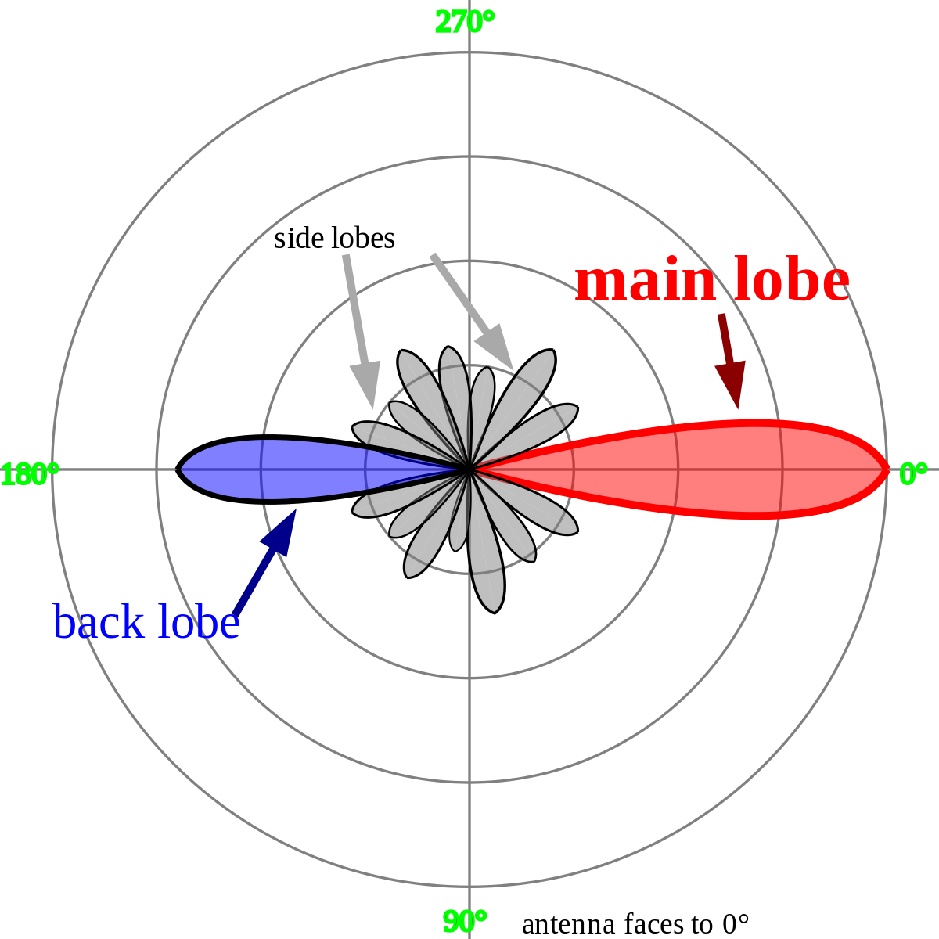
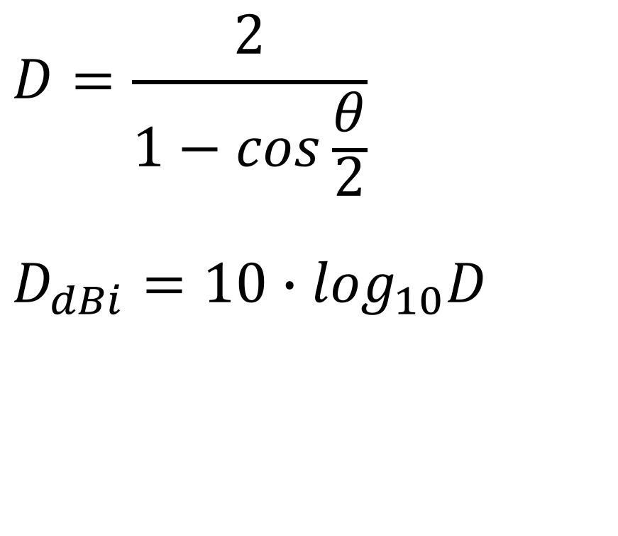
Directivities
$$D=\frac{2}{1−cos\frac{θ}{2}}$$
$$D_{dBi}=10∙\log_{10}D$$
Notes:
看個角度的訊號最強 以 D 表示之

Slide 28

Isotropic Radiator
Notes:
dBi 的 ｉ的意思是 從點來源發散出的訊號的 能量（dB）

Slide 29
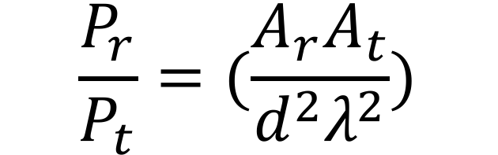
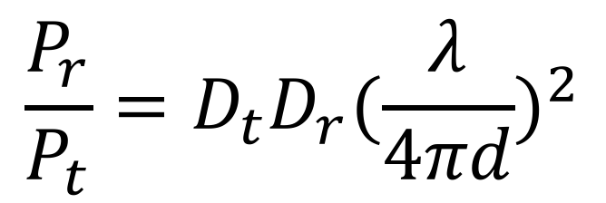
$$\frac{P_{r}}{P_{t}}=(\frac{A_{r}A_{t}}{d^{2}λ^{2}})$$
$$\frac{P_{r}}{P_{t}}=D_{t}D_{r}{(\frac{λ}{4πd})}^{2}$$
Notes:
從一開始有效天線面積到最後常用的 directivity 來呈現天線的效能

Slide 30
Channel Fading Summary
Small-scale fading
Doppler spread
Slow fading
Fast fading
Delay spread
Flat fading
Frequency-selective fading
Large-scale fading
Path loss
Shadowing
Mobility
Multipath
Notes:
Small scale
以 time domain 來分類，Doppler mobility Delay multipath
Large scale
Path loss shadowing

Slide 31
Demo
Notes:
看 matlab 小示範

Slide 32
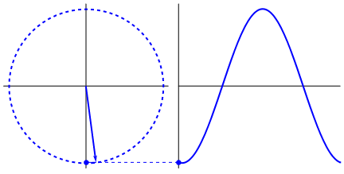
Notes:
剛剛畫出來的圖是 圓形的原因

Slide 33
Outline
Channel
Friis Transmission Equation
RFID
RFID
Notes:
最後一部份是介紹我目前的研究

Slide 34
Basic Elements
Notes:
基礎設備介紹

Slide 35
RFID Standard
Bar code
Traditional wireless
identification
Defacement
Line of sight
Manual manipulation
Read separately
Radio Frequency IDentification
Brand new wireless
identification
RF based communication
Non-line of sight
System based operation
Read simultaneously
Notes:
最傳統最常見的無線辨識碼是所謂的 bar code
雖然很方便，但卻有許多缺點必須很近、表面必須乾淨、LOS
LOS tx 與 rx 之間沒有障礙物
RFID tag 可以同時很多一起讀 NLOS 不易毀損

Slide 36
RFID Reading Frequency
Frequency | Price range | Read Range | Limitations | Applications
Low Frequency 125-134 kHz | low | Low ( < 1 m.) | Low reading speed | Animal tracking
High Frequency 13.56 Mhz | Low to Middle | Low ( < 1.5 m) | Problems with metal | Library, access control
Ultra-high Freq. 860-930 MHz | Middle to High | High ( > 10 m) | Interference problems | Vehicle tracking
Microwave 2.4 GHz | High | High ( > 50 m) | Not widely deployed | Vehicle access control
Notes:
Tag 有幾種不同的讀取頻率
目前主要是用 Ultra high freq.

Slide 37
RFID Reading Frequency
國內RFID頻段
FCC開放RFID頻段
中華電信
Up link
遠傳
UP
RFID
中華電信
Down link
遠傳
DL
增頻
增頻
MHz
891.4
895
902
910
915
922
928
940
955
960
892
937
Notes:
每個頻段都會經過分配，目前國內使用 RFID 的頻段是 922~928 MHz
再來介紹 RFID 使用物件及特性

Slide 38
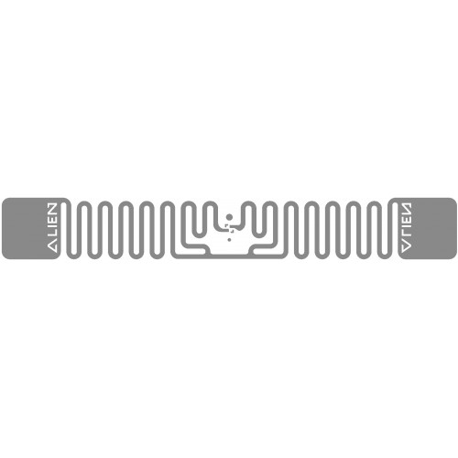

RFID Setting
Tag Type | Reading Distance | Characteristic
Passive | < 4m | Battery free Cheap
Active | > 100m | Battery loaded Expensive
Notes:
Tag 分成兩種都是靠反射來傳送訊息
Passive 利用 reader 訊號做充電
Active 就是 裝電池或有其他充電來源

Slide 39
RFID Setting
Tag Type | Reading Distance | Characteristic
Passive | < 4m | Battery free Cheap
Active | > 100m | Battery loaded Expensive
Notes:
常用的是 passive

Slide 40
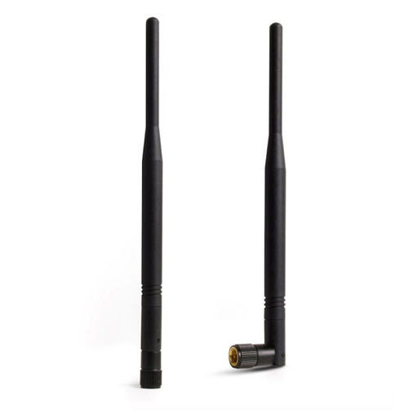
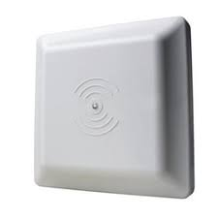
RFID Setting
Notes:
天線基本上有兩種型態
當 reader 同時扮演 rx tx 的角色

Slide 41
RFID Setting
Notes:
將 tag 放在不同位置會有不同的 效果
發現右邊這種放法收到的訊號比較好

Slide 42
Protocol

Slide 43
Backscatter
Notes:
一個 passive tag 一個 reader

Slide 44


Backscatter
Carrier Wave
Power
Notes:
Reader 會透過穩定的 carrier wave 送能量給 tag
讓 tag 有能量回傳資訊

Slide 45
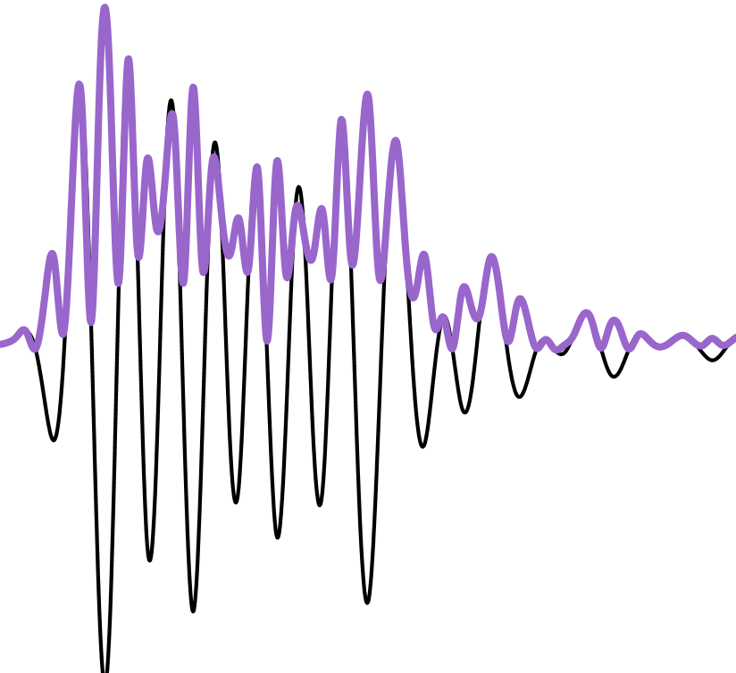
Backscatter
Notes:
Reader 會根據使用者要做的指示將訊號轉成可傳送的波

Slide 46
Backscatter
Notes:
Reader 送到每個 tag

Slide 47
Backscatter
Power
Command
Notes:
Tag 同時收到能量及訊息

Slide 48
Backscatter
Notes:
將回應轉成可送的波

Slide 49
Backscatter
Notes:
回送給 reader

Slide 50
Backscatter
Notes:
Reader 收到來自 tag 包含回傳carrier wave 及 回復 的波

Slide 51
Backscatter
Notes:
透過 decode 技術把 carrier wave 拿掉得到正確的 訊號

Slide 52
Backscatter
Notes:
最後轉回可被電腦分析的訊號即完成一趟下達指令的流程

Slide 53
UHF EPC
Physical Layer
RFID tags communicate by “backscattering” signals that are concurrent with reader transmissions, and use a variety of frequencies and encodings under the control of the reader.
MAC Layer
Readers and tags use a variation on slotted Aloha to solve the multi-access problem in a setting where readers can hear tags but tags cannot hear each other.
Notes:
圖解完後解釋如何解開訊號
實體層是透過頻率變化及reader encode 做出訊號
主要適用 slotted Aloha 解決多 tag reader 的問題
接下來解釋這兩層的資訊

Slide 54
UHF EPC
Physical Layer
Physical Layer
RFID tags communicate by “backscattering” signals that are concurrent with reader transmissions, and use a variety of frequencies and encodings under the control of the reader.
MAC Layer
Readers and tags use a variation on slotted Aloha to solve the multi-access problem in a setting where readers can hear tags but tags cannot hear each other.

Slide 55
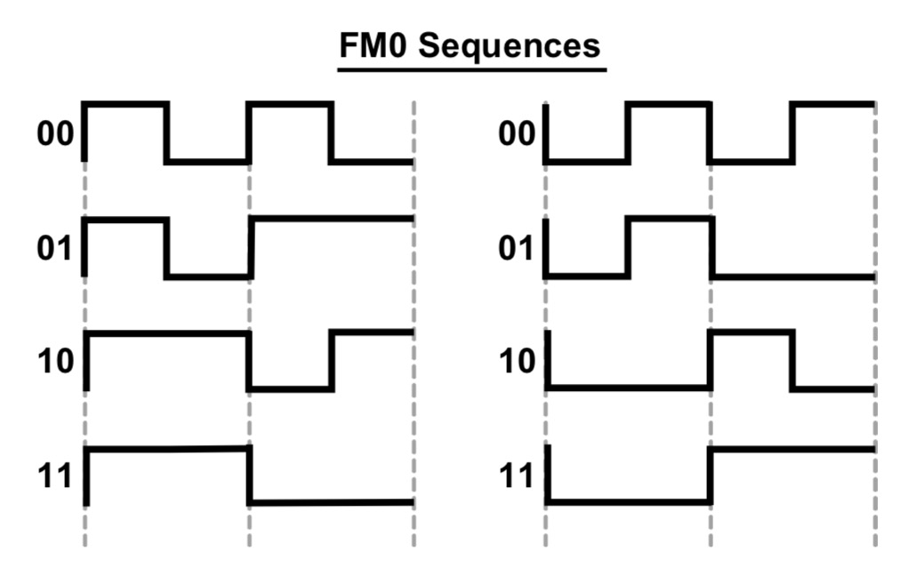
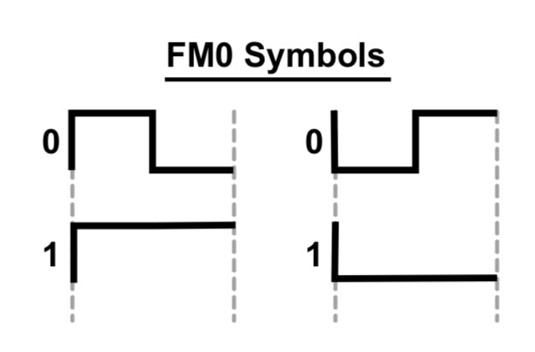
FM0
Notes:
訊號的編碼
一個週期分兩小段來看 中間有轉折的為 0
沒有轉折為 1

Slide 56
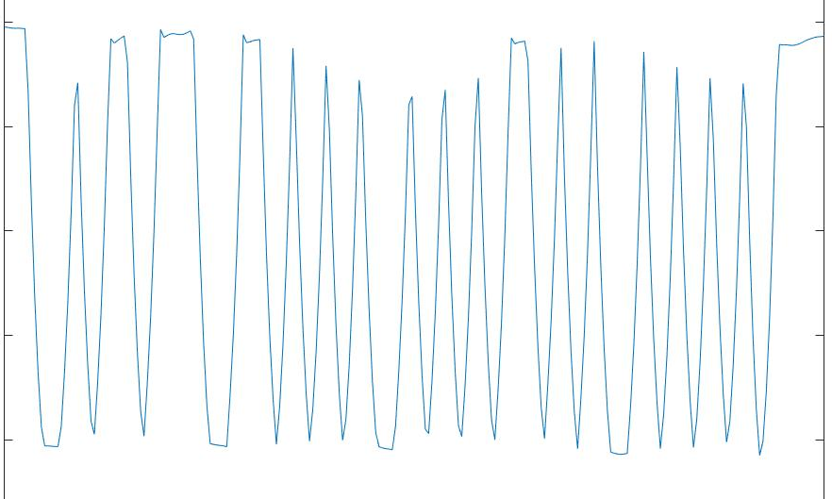
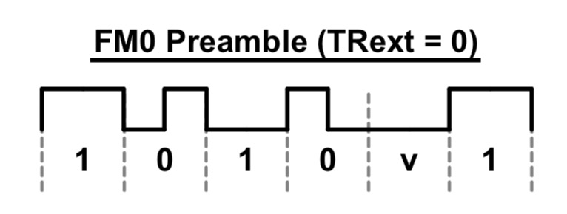
FM0
1
0
v
1
0
1
Preamble
Notes:
以 Tag 回傳的 RN16 訊號為例
前面是 reamble

Slide 57
MAC Layer
Based on Framed Slotted Aloha
Each frame has a number of slots
Each tag will reply in one randomly selected slot per frame
The number of slots in the frame is determined by the reader and can be varied on a per frame basis
Notes:
簡單介紹最基本的 slotted Aloha
一段訊號運送時間 稱為一個 frame，所有tag 會在這段時間完成所有事
每個 frame 有許多 slots 每個 tag 會隨機選擇一個 slot 回傳訊號
每段 frame 中的 slot 有可能因為不同的需要而有所改變

Slide 58
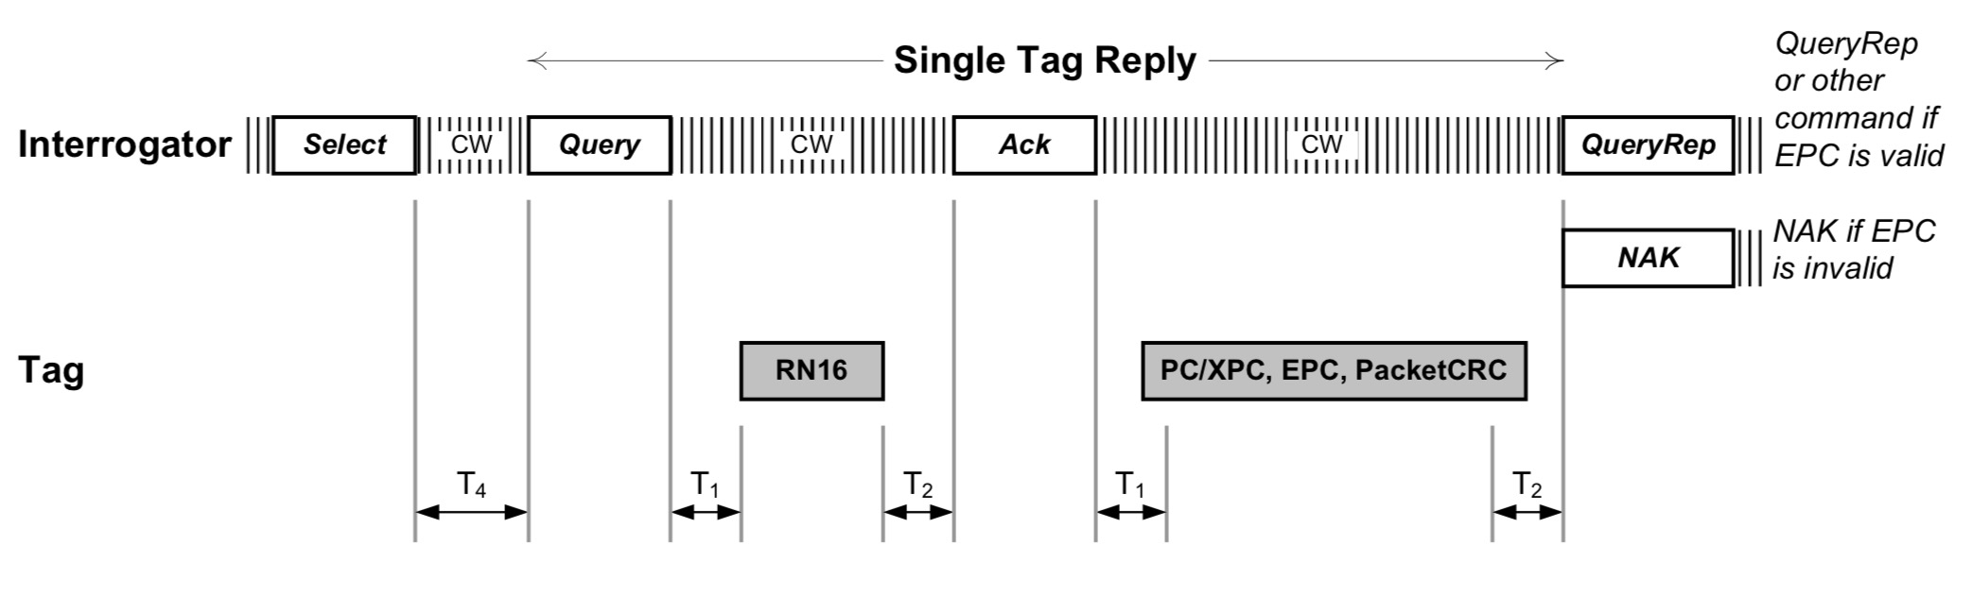
Query round
Notes:
這是一個收到 tag 的正確流程

Slide 59
Query round

Slide 60
Query round
Query Round
an individual frame : Query Cycle
the series of Query Rounds between power down periods
The reader can optionally transmit a Select command
Limits the number of active tags by providing a bit mask only tags with ID’s (or memory locations) that match this mask will respond in the subsequent round
Notes:
Selected command 就像字面上的意思一樣
可用可不用，主要是用限制 tag 回傳數量

Slide 61
Query round

Slide 62
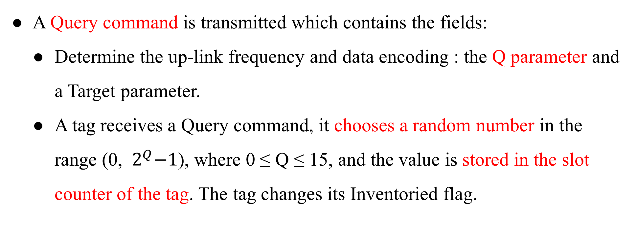
Query round
A Query command is transmitted which contains the fields:
Determine the up-link frequency and data encoding : the Q parameter and a Target parameter.
A tag receives a Query command, it chooses a random number in the range (0, ${ 2}^{Q}−1$), where 0 ≤ Q ≤ 15, and the value is stored in the slot counter of the tag. The tag changes its Inventoried flag.
Notes:
Query 階段會 送出一個 0~15的 Q值 及 目標參數用來設定要蒐的 tag
所有Tag 收到此訊息會以 Q 值產生隨機數字開始倒數直到0

Slide 63
Query round

Slide 64
Query round
If a tag stores a 0 in its slot counter, it will transmit a 16 bit random number (RN16) immediately.
The reader will echo the RN16 in an ACK packet after receiving it.
If the tag successful receives the ACK with the correct random number, the tag will backscatter its ID.
Notes:
倒數到 0 tag 會回傳 RN16 就是 16 bits 的隨機數字
編碼也是用 FM0
Reader 成功收到 RN16 會回復 RN16 以及 ACK
Tag 收到後會回傳 ID

Slide 65
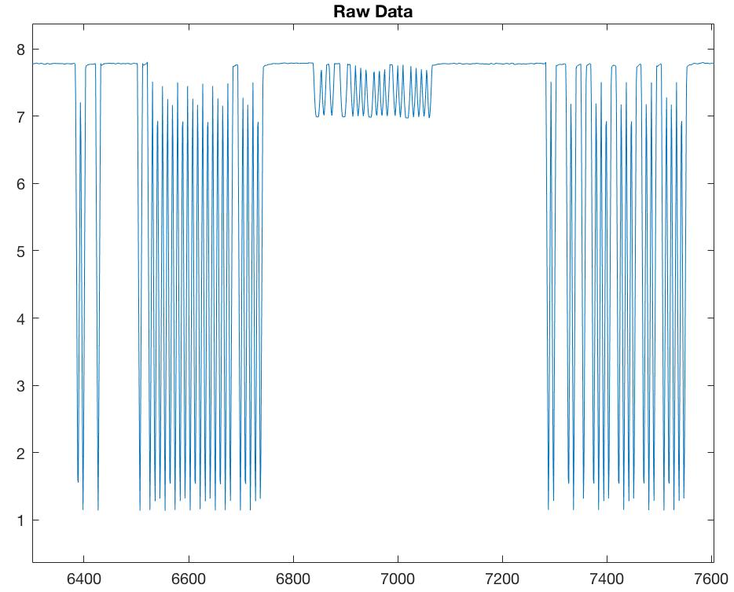
Notes:
這是實際收到 RN16 的訊號圖

Slide 66
RN16
0
0
0
1
0
0
0
0
0
0
1
0
0
1
0
1
Preamble
RN16
Notes:
經過 decode 應該會是

Slide 67
Query round

Slide 68
Query round
The reader will send a QueryRepeat command to cause the tag to toggle its Inventoried flag.
If the ID was not successfully received by the reader, a NAK command is sent which resets the tag so that a subsequent QueryRepeat will not result in Inventoried flag being changed.
A QueryRepeat signals is the end of the slot.
Notes:
若 reader 收到不對的 ID 格式，會送 NAK 讓下次 Query 知道沒有這個 ID
成功的話會用 QueryRepeat 結束這 slot 同時也看下一步要做甚麼

Slide 69
Query round
On receiving the command, the remaining tags will:
Decrement their slot counter
Respond with a RN16 if their slot counter is set to 0.
The process then repeats, with the number of QueryRepeats being equal to the number of slots set using the Q parameter.
Notes:
其他 tag 會
倒數直到 0
不斷重複以上步驟

Slide 70
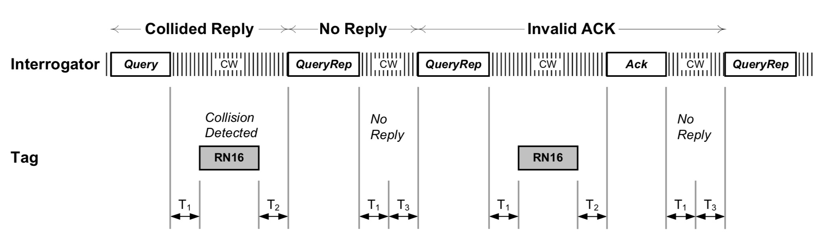
Query round
Notes:
撞掉失敗，或是沒有人倒數到 0

Slide 71
Related Work
Fundamental
Michael Buettner , David Wetherall An empirical study of UHF RFID performance. 14th ACM Int. Conf. on MobiCom
EPCglobal. Epc radio-frequency identity protocols class-1 generation-2 uhf rfid protocol for communications at 860 mhz-960 mhz version 2.0.0. , 2013
Notes:
簡單的有一篇 paper 可以看
還有 EPC 規格說明

Slide 72
Related Work
Localization
Jue Wang, Dina Katabi Dude, where's my card?: RFID positioning that works with multipath and non-line of sight. the ACM SIGCOMM, 2013
Tracking
Lei Yang, Yekui Chen Tagoram: Real-Time Tracking of Mobile RFID Tags to High Precision Using COTS Devices. ACM Int. Conf. on MobiCom, 2014
Device-free
Chuyu Wang, Jian Liu, Yingying Chen Multi-Touch in the Air: Device-Free Finger Tracking and Gesture Recognition via COTS RFID. IEEE Infocom, 2018
Notes:
以下是RFID 的相關問題的 代表 paper

Slide 73
Related Work
Search tags
Jihong Yu, Wei Gong, Jiangchuan Liu Fast and Reliable Tag Search in Large-Scale RFID Systems: A Probabilistic Tree-based Approach. IEEE Infocom, 2017
Find missing/unknown tags
Muhammad Shahzad, Alex X. Liu Fast and Reliable Detection and Identification of Missing RFID Tags in the Wild. IEEE/ACM Transactions on Networking, 2016
Find moving tag
Chuyu Wang, Lei Xie, Wei Wang Moving Tag Detection via Physical Layer Analysis for Large-Scale RFID Systems. IEEE INFOCOM, 2016
Notes:
以下是RFID 的相關問題的 代表 paper

Slide 74
Reference
https://www.flaticon.com/
https://www.sitebuilderreport.com/stock-up
https://en.wikipedia.org/wiki/Friis_transmission_equation
https://en.wikipedia.org/wiki/Path_loss
https://ccrma.stanford.edu/~jos/fp/Phase_Delay.html
https://en.wikipedia.org/wiki/Communication_channel
https://en.wikipedia.org/wiki/Fading
http://www.sengpielaudio.com/calculator-timedelayphase.html
EPC RFID protocols Class-1 Gen2 UHF RFID protocol for communications
An empirical study of UHF RFID performance
Notes:
所有參考資料

